Slide 1

University Institute of Liberal Arts and Humanities
Course Name – Communication Skills
Course Code – 23PCH-105
ACTIVE AND PASSIVE VOICE
DISCOVER . LEARN . EMPOWER

Slide 2
COURSE OBJECTIVES
The Course aims to:
1 | Augment students overall communication and interpersonal skills by making them realize the importance of good oral and written English Language in professional life.
2 | Enrich their reading capability with special emphasis on expanding vocabulary and grammatical formations.
3 | Build exceptional speaking, reading and writing skills by correcting grammatical errors and pronunciation through practice.
4 | Enhances soft skills by fostering self awareness, confidence and a positive attitude in students’ ability to communicate effectively in English.

Slide 3

COURSE OUTCOMES
On completion, the students are expected to
CO Number | Title | Level
CO1 | Apply appropriate Listening, Speaking, Reading and Writing Skills (LSRW Skills) with correct non-verbal cues to attain expertise in soft skills. | Apply
CO2 | Apply correct contextual and comprehensible written text in the form of paragraph writing, short compositions business correspondence, using logical support and argument in a wide range of communication situations. | Apply
CO3 | Demonstrate linguistic competence while speaking and during presentations through accuracy in grammatical usage, vocabulary, pronunciation and intonation. | Apply
CO4 | Evaluate information as critical readers, speakers and writers applying ethics in communication and being sensitive in cross cultural communication. | Evaluate
CO5 | Create original, digital content for websites, blogs, vlogs and personal social media profiles etc. | Create
www.istockphoto.com

Slide 4
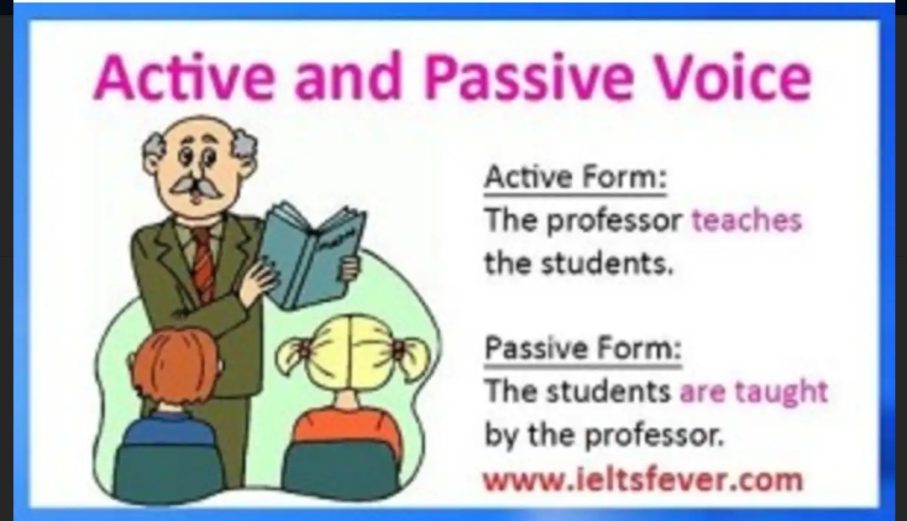
Voice
Voice is the form of a verb
takes to indicate whether the
subject of the verb performs
or receives the action.
There are two types of voice:
Active voice
Passive voice
URL for imhttps://ieltsfever.org

Slide 5
Active Voice
Active voice indicates that the subject of the verb is acting. E.g.
The police is catching the robbers.
The police (subject) is doing the catching (verb).
Because the subject does or “act upon” the verb in such sentences,
the sentences are said to be in active voice.
It follows a clear subject + verb + object construct that's easy to
read.

Slide 6
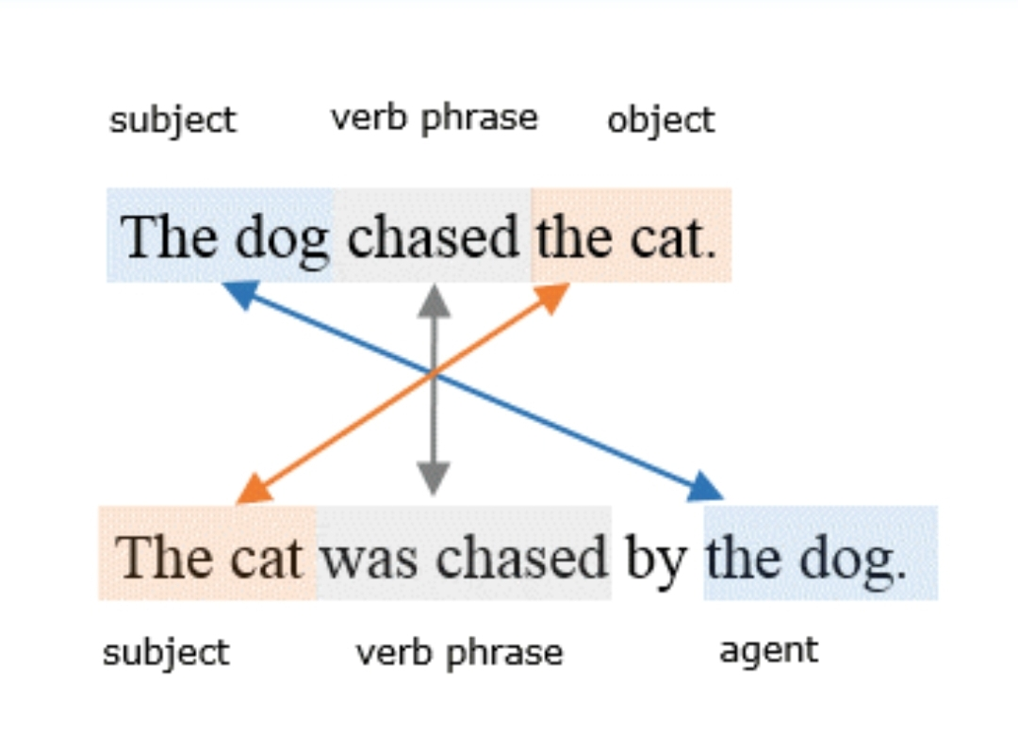
Passive Voice
In a passive voice sentence the subject and the object flip-flop. The object takes the position of a subject and the subject becomes the passive recipient of the action.

Slide 7
Transformation of Active into Passive Voice
Some rules to follow:-
1.When the subject of the active voice becomes the object of
the passive voice, it is generally preceded by the preposition
“by”. E.g.
He likes you.
You are liked by him.

Slide 8
Transformation of Active into Passive Voice
2. If there are two objects in an active construction, it is better to
transform the sentence from direct object which is placed
immediately after the verb. E.g.
Rakesh teaches us English.
We are taught English by Rakesh.

Slide 9
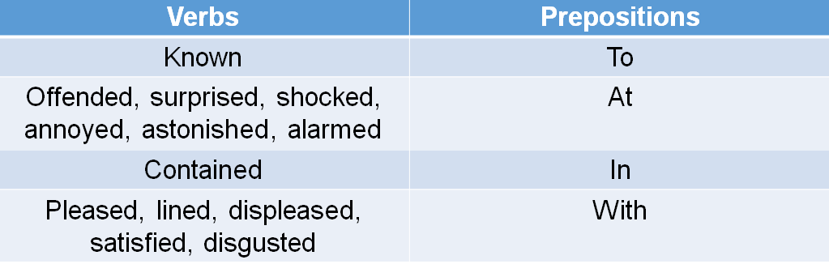
Transformation of Active into Passive Voice
3. There are certain verbs such as know, surprise, shock, astonish, annoy, contain, please, displease, satisfy etc. which take different prepositions in the passive voice:

Slide 10
Poll Question-1
Q:- The police is looking into the matter.
1. The matter is being looked into.
2. The matter is being looked by the police.
3. The matter is being looked into the police.
4. The matter is being looked into by the police.

Slide 11
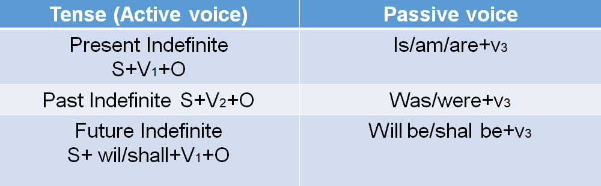
Transformation of Tenses
4. In the passive voice the subject is followed by the “be” form of the verb, such as- is, am, are, was, were, been, being and be and, and the third form of the verb (v3).

Slide 12
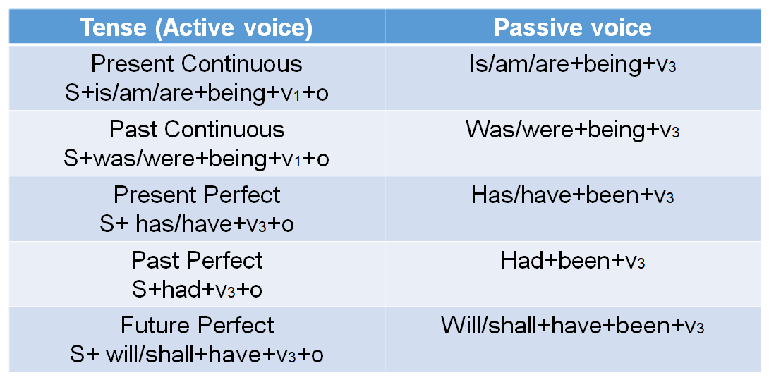
Transformation of Tenses

Slide 13
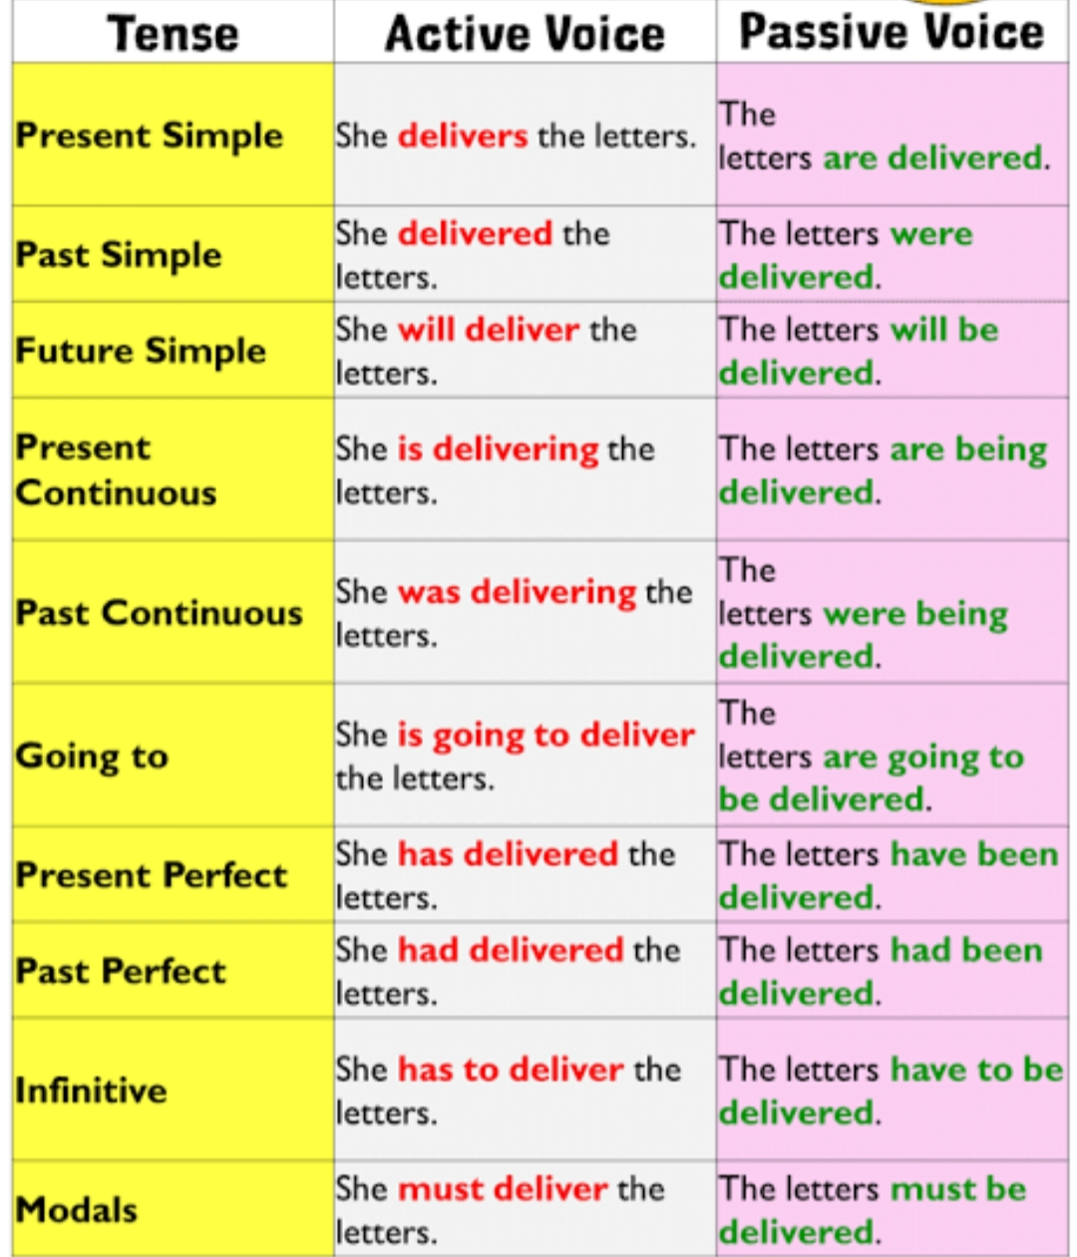
Transformation of Tenses

Slide 14
Transformation of Interrogative Sentences
5. While changing interrogative sentences from active to passive use
the following sentence structure- helping verb + subject + v3
For example:-
Does he keep his promise?
H.V + S + V1 + O
Is his promise kept by him?
H.V + O + V3 + S

Slide 15
Transformation of Interrogative Sentences
6. However, in Wh-words the following structure is followed-
Wh-words+ helping verb + subject + v3. e.g.
What will you buy?
What will be bought by you?
Who is dusting the room?
By whom is the room being dusted?
How will you do it?
How will it be done by you?

Slide 16
Poll Question- 2
Q:- Why did you wait for her?
1. Why she was waited for by you?
2. Why was she waited for by you?
3. Why she was waited by you?
4. Why was she waited for you ?

Slide 17
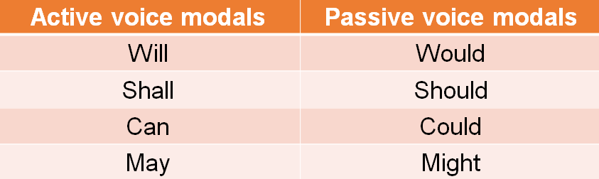
Transformation of Sentences with Modals
7. Modals such as will, shall, can, may are followed by
past form of modals + be + v3 . e.g.

Slide 18
Poll Question- 3
Q:- They will demolish the entire block.
1. The entire block is being demolished.
2. The block may be demolished entirely.
3. The entire block will have to be demolished by them.
4. The entire block will be demolished by them.

Slide 19
Transformation of Imperative Sentences
8. To change the active construction of imperative sentences use
Let + subject (the object of active voice) + be + v3.
For Examples:-
1.Touch this screw.
Let this screw be touched.
Let + S + be + v3
2. Solve these sums.
Let these sums be solved.

Slide 20
Transformation of Imperative Sentences
9. Imperative sentences can also be transformed by using the words such as- requested, ordered, suggested, advised etc.
For example:-
1. Chew your food slowly.
You are advised to chew your food slowly.
2. Shut the door.
You are ordered to shut the door.

Slide 21
Transformation of Imperative Sentences
3. Leave the room at once.
You are ordered to leave the room at once.
OR
Let the room be left at once.
OR
The room should be left at once.

Slide 22
Practice Exercise
They were being paid.
Allison was sending him to a high school.
They will make large sums of money.
A face was being painted on it.
Who teaches you English?
She uses my nice carpet when I was absent.
I will never forget this experience.
Did she do her duty?
This pot contains milk.

Slide 23
Answers
The company was paying them.
He was being sent to a high school by Allison.
Large sums of money will be made by them.
She was painting a face on it.
By whom are you taught English?
My nice carpet is used by her when I was absent.
This experience will never be forgotten by me.
Was her duty done by her?
Milk is contained in this pot.

Slide 24
APPLICATIONS
Teaching grammar to students is to think from creative angles.
It’s about having the ability to organize words, phrases, and sentences for maximum communication power.
If students don’t know grammar, they don’t know what’s possible with the English language.

Slide 25
Assessment Pattern
Students are assessed on the basis of the following parameters:
Hourly Tests - 2
Assignments
Surprise Test
Quiz
Student Engagement
End Semester Exam

Slide 26
REFERENCES
Reference Books:-
Murphy, R., Essential Grammar in Use, 5th Edition Cambridge
University Press (2018), UK
Hewing, Martin, English Grammar (Intermediate Level), Cambridge
University Press (2017), UK
Reference Websites:-
https://www.slideshare.net/idahisyam/active-and-passive-voice-ppt-
53307051
https://www.academia.edu/31597806/GrammarVoice_and_Narration

Slide 27
THANK YOU
For queries
Email: communicationskills.uilah@gmail.com

